Slide 1

My 3 Computer components
By Chris Pinto

Slide 2
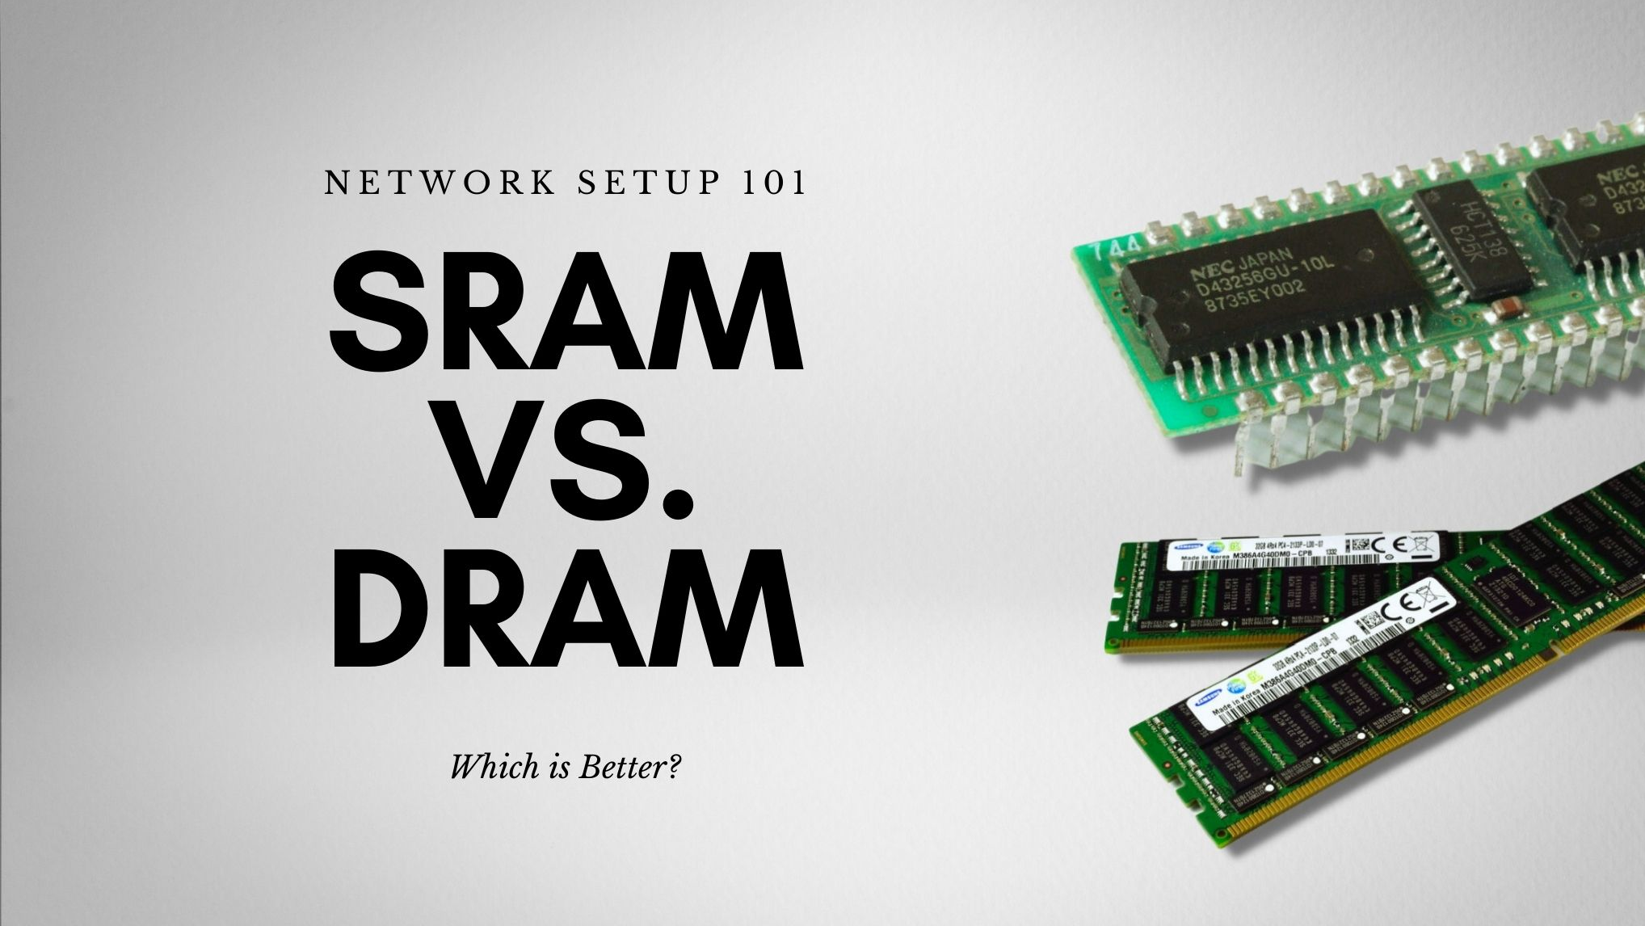
Memory
A Device that is used to store data or programs on a temporary or permanent basis
D-Ram
Slower than S-Ram
Volatile memory (“When you cut power anything stored in D-Ram quicky fades away”)
S-Ram
Volatile (”Capable of much higher performance and doesn’t need to refresh data”)
Fast access
Flash Memory
Non-Volatile
Less performance
Limited write cycles
Fact (The S-Ram was invented in 1963 by Robert H. Norman)

Slide 3
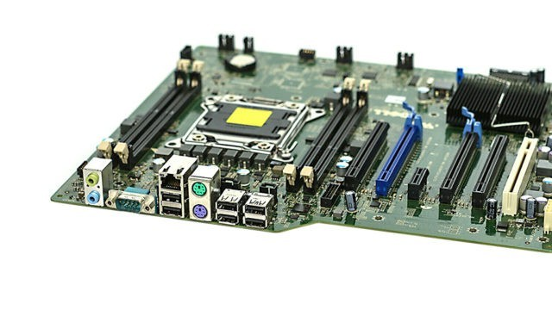
Motherboard
“A printed circuit board containing the principal components of a computer or other device”
(It allocates power and allows communication to and between the CPU, RAM and all other computer hardware)
Fact (”The motherboard was invented in 1981 and was said to be originally referred to as “Planar” or “Breadboard”

Slide 4

BIOS (Basic Inside Outside System)
”A firmware used to perform hardware initialization during the booting process”
(Built-in core processor software responsible for booting of your system)
Fact (Invented in 1975 by American scientist Gary Kildall)

Slide 5
Events and people
By Chris Pinto

Slide 6
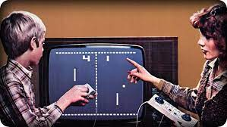
Pong
Developed in 1972 by Allan Alcorn in Sunnyvale California
This event helped to establish the video game industry
For the First time people could control something on their TV display
Fact ( Atari did not want to build pong they wanted to license it to a larger manufacturing company

Slide 7
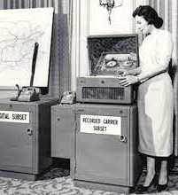
The Modem
The Early Modems were used by the US Airforce in 1950’s
But the first commercial ones were made a decade later
Invented by Dale Heatherington and Dennis Haynes.
Without the invention of the modem, we would not be able to run computers on internet
Fact (The earliest modems were about 75bps)
(Bits Per Second)

Slide 8
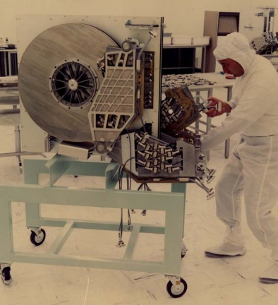
The First Hard Drive
Invented in 1957 by IBM and Reynold B. Johnson
Without the Hard Drive invented we wouldn’t be able to store data on the computer
IBM ships this Hard Drive for a whopping $10000 per megabyte
Fact (The RAMAC held 5mb of data and was as big as 2 refrigerators)

Slide 9
3 Failures in computer industry

Slide 10
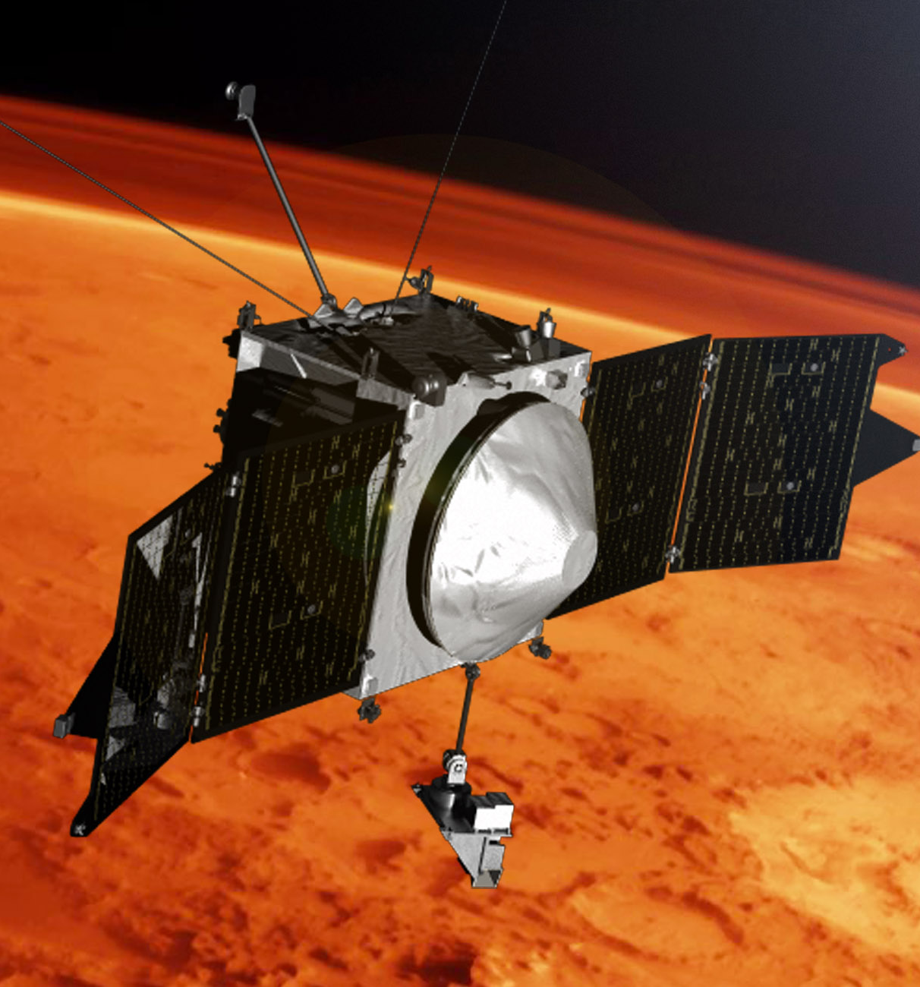
Mars Climate Orbiter
December 11, 1998, by NASA
“Violently burned up and destroyed in the atmosphere”
Some teams used Metric and some Used Imperial, causing a conversion error
Fact (It was designed to be able to study Mars from orbit)

Slide 11
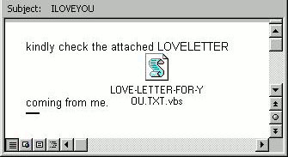
ILOVEYOU.TXT
May 5th, 2000, A letter is spread around containing a file labeled “LOVE-LETTER-FOR-YOU.TXT”
Millions of people opened it out of curiosity
(Causing their computer to overwrite files and send a copy of itself to every address on outlook)
Later fixed causing $15 Billion to remove from computer systems
Fact (It caused approximately $8 Billion in damages worldwide)

Slide 12
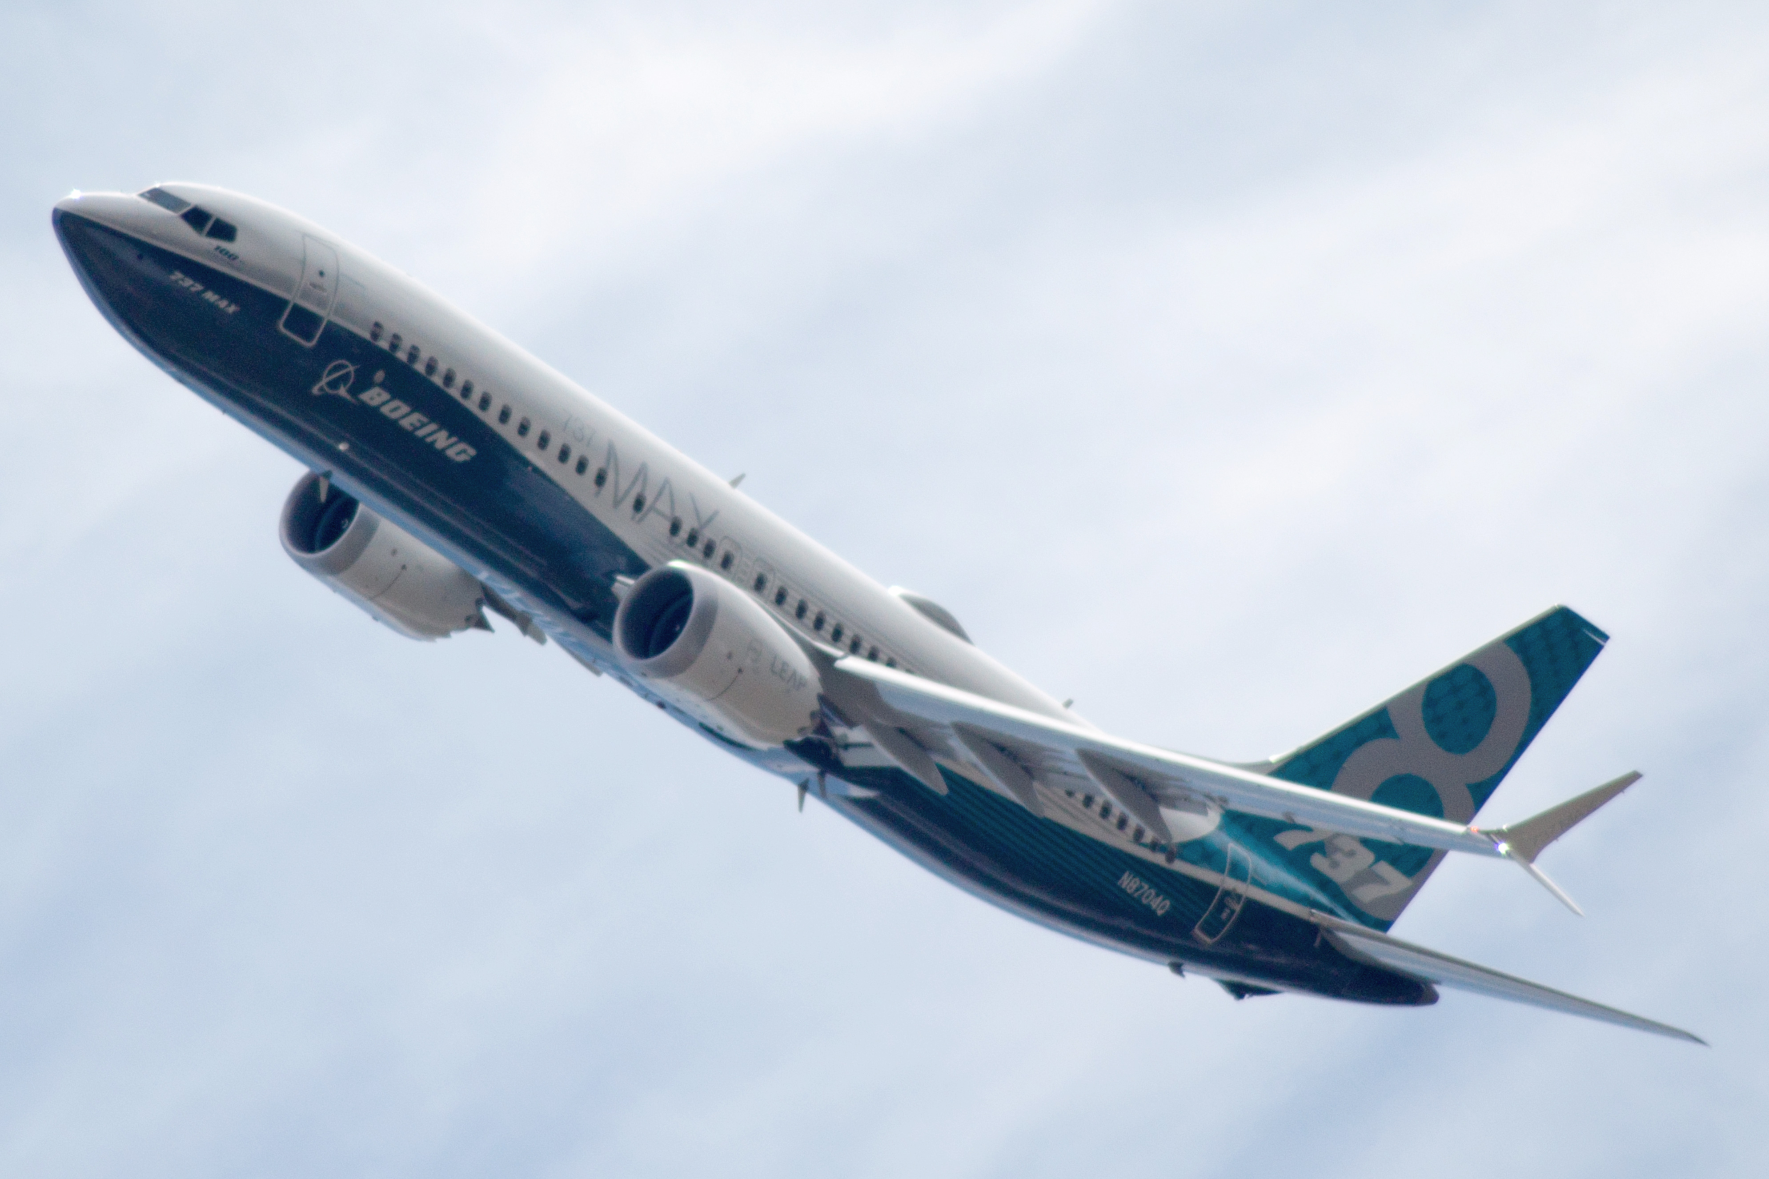
Boeing 737 MAX
Developed in 1960s
MCAS systems automatically pushed the nose of the aircraft down when excessive angle of attack is detected
(This software led to two crashes)
Instead of MCAS to save money the better option is to train the pilots
Fact (345 lives were lost because of the MCAS system)

Slide 13
3 Career Choices

Slide 14

Systems Architect
In charge of maintaining systems and networks for a company, overall design and cost analysis
Sources report that employment market will grow 8% from 2018 to 2028
$109,161/year

Slide 15

Data Scientist
Takes large amount of data and funneling down and organizing it
Analyzing data to identify patterns and trends
“Data Science jobs are some of the fastest growing jobs since 2012” – Brain station
Makes about $113,309/year

Slide 16
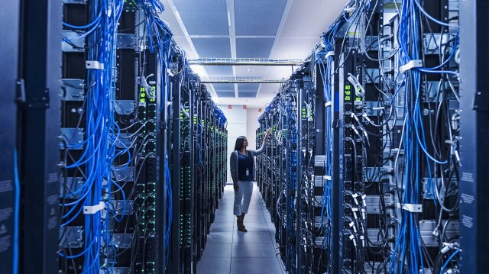
Computer Network Architect
Works on ways to send large amounts of data while keeping it secure
Upgrade hardware such as routers or adapters
Employment is projected to grow 5% from 2020 to 2030
Makes around $120,666/year

Slide 17

10 Things Every Programmer Should Know
Data Structures and Algorithms
IDEs
Source Control
Microsoft Excel
Linux
Text Editors
Programming Languages
Networking Basics
Scripting Languages
Database and SQL

